Slide 1
Intro to html
MCNDHS
Ms. Eng

Slide 2
aim: What are some semantic html tags?
Do now:
Daily Grade:
On-time/attendance/not leaving the classroom: 25%
Cellphones: 25%
Notes:25%
Classwork/Homework: 25%

Slide 3
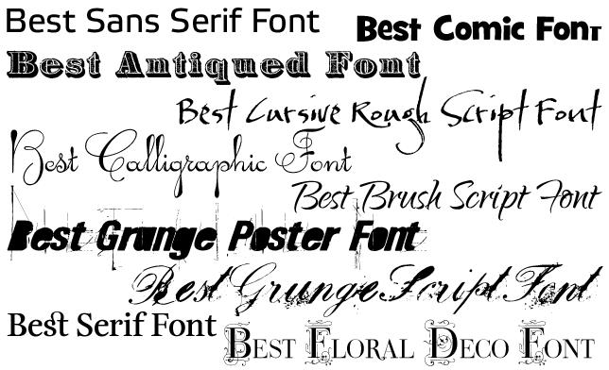
semantic html
semantic html is html that you use to alter text

Slide 4
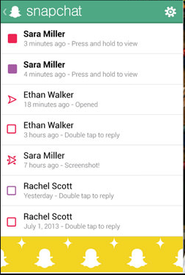
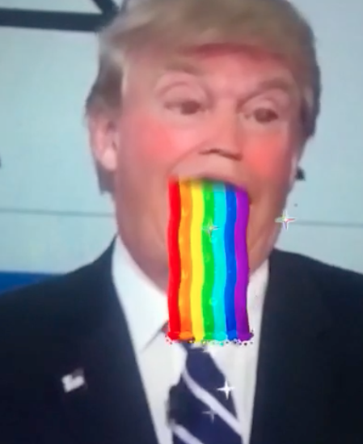
where you see it…

Slide 5
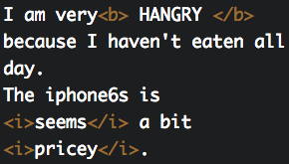

bold and italic
Bold: <b> </b>
Italic: <i> </i>

Slide 6




superscript & Subscript
Superscript: <sup></sup>
Subscript: <sub></sub>

Slide 7
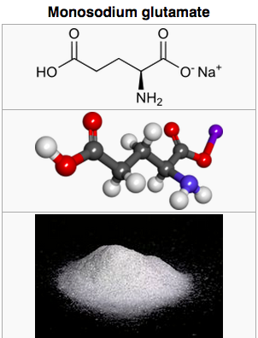
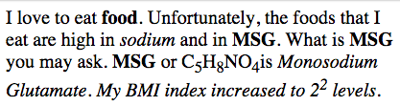
activity
Question 1:
Write your name and circle all the text that you believe was affected by semantic html
Question 2:
Recreate the following text:

